Slide 1
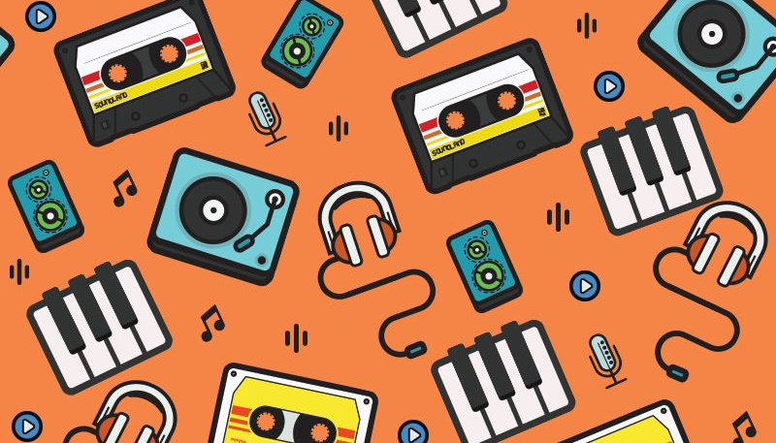
Song recommender
Leveraging our company and making it to the next step
Notes:
When i was assign to the project of a song recommender, i had an immediate idea popped into my mind.
One day a friend and i were talking about supporting minorities. AndI told him well, as a women, and someone that needs to fight for equality, I learned a long time ago that I had to actively pay attention to what I was reproducing and consuming. For example,I read a lot. it’s been a looong time since I actively try to read books written by minorities. So I read a lot of books written by women, by latinos, by people from different nationalities. Because if you don’t pay attention, you end up reading, in a great majority, books from white men from the US or UK. And besides from that giving you a very limited perspective, diversifying what you consume also supports those other people that have low visilibity and are struggling to make in the industry. And that are equaly alented
So I was giving this whole speech, and he asked: wow, nice, give me some recommendations because I want to do it as well. Do you also do it with music?
And I was like OF Coooooour…. And then I realized my favorite singers are men. And this really bothered me because I though I was such a good feminist!
And since this conversation I can tell you: I pay attention, but it’s very hard and it takes a lot of effort to find music I like that is necessarily by a female singer.And I’ll tell you why:

Slide 2






Music Industry Facts
Around 80% of artists on the year end charts are male and 20% are female.
Since 2013, more than 1000 artists were nominated to the grammy award, around 90% were men
The whole industry makes it harder for female artists:
Woman experience stereotyping and sexualization
Their skills are dismissed by producers
If a huge part of what builds our music taste comes from exposure...
...no wonder it is so hard to “equalize” and find a great variety of songs by female that we like!
Notes:
Whe spotify recommends me a song, I don’t think I have the option to felter it and make a song by a female. And since I listen to male arstists, and the database they have is made by a lot more men, they keep giving me male songs and I can not break this circle.

Slide 3
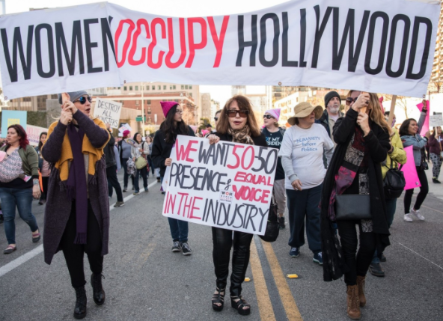
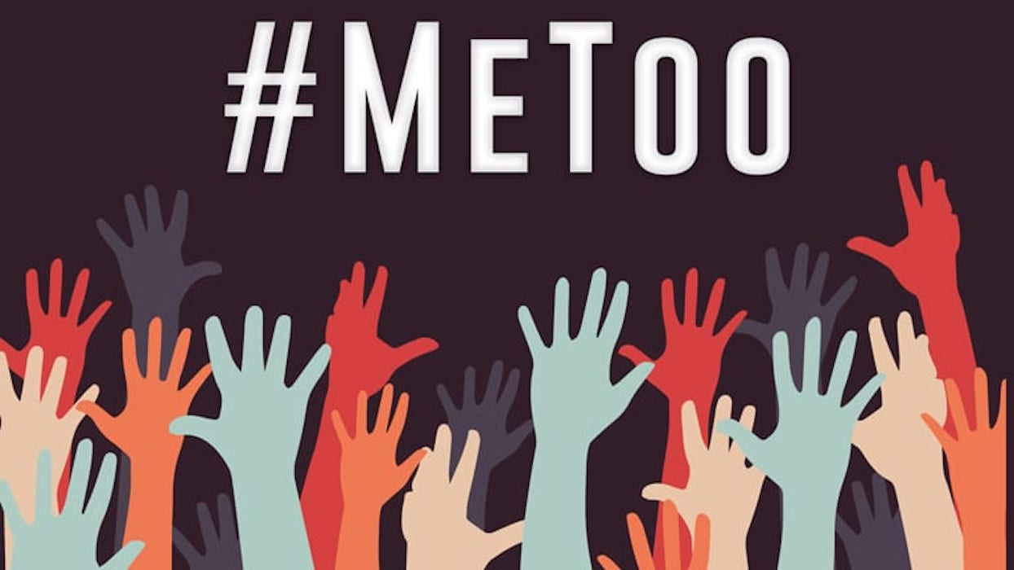
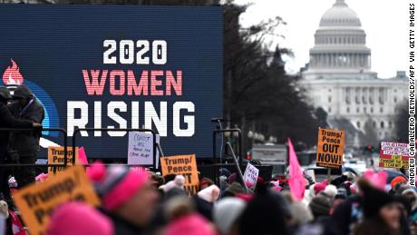
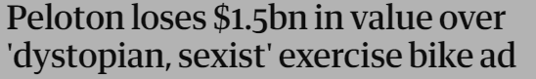
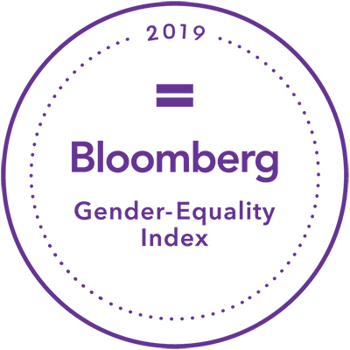
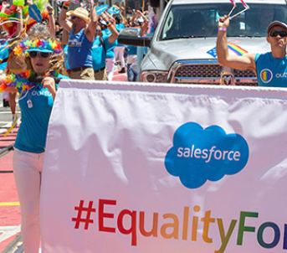
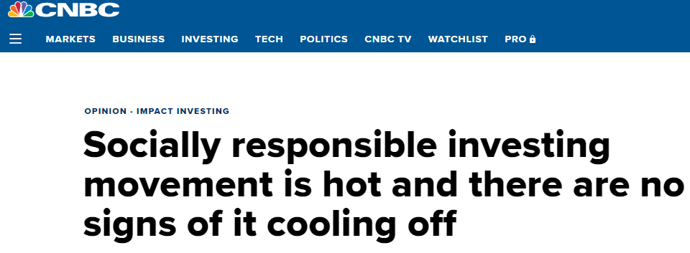
People are actively going for equality and social causes
Companies are learning they need to follow
#GrammySoMale
Notes:
But, justa s my friend and I, people are starting to notice that! I don’t need to extend myself a lot here because you are livign in the same world as I am. But there is an important mindset change going on.
And companies already noticed they need to follow! People stay and support companies that support causes. There is research saing we left the digital era, and we are going to an era of purpose. The world is moving, and companies need to move with it: me too movement, black lives matter, companies losing value on the stock market because of prejudice and racis, companies gaining value for supporting causes> not only on facebook, but for real. The companies that survive, are companies with a purpose. There is a rank with social responsible brands.

Slide 4

A song recommender that helps people to support a cause
In the main Gnoosic page, user chooses if they want recommendations only of songs by female artists
User inputs ANY song they like
We get the features of that song, and match features of a similar song from our database, that has only female artists
User finds out good female artists who can rap, rock, be a dj, and whatever they want
Notes:
They say that if you stay still, you’re automatically picking a side. So my proposal here, is for us to step up. Lets help people to activally search for song by females that they like and i say females here because, as a woman, this cause speaks to my heart, but as a consumer, i would also like to explore good songs from black artists, latino artists, and so on. So this is only the beginning.

Slide 5

Notes:
https://www.billboard.com/articles/news/8096196/new-report-shows-major-lack-representation-women-music-industry/
https://www.statista.com/statistics/801059/share-of-females-popular-music/
https://www.forbes.com/sites/caitlinkelley/2019/02/06/music-industry-study-annenberg-gender-equality/?sh=544a5cf45f81

Slide 6
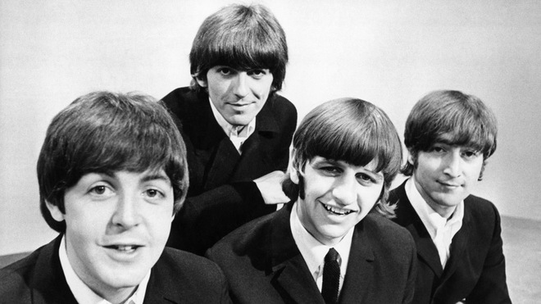
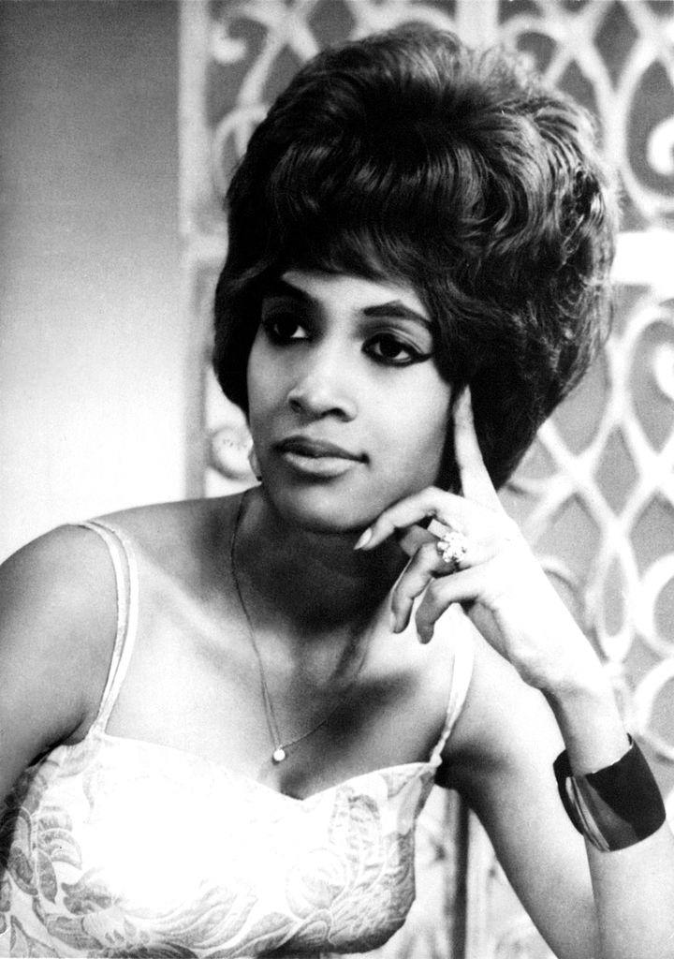

Next steps- product
Next steps- company
Since it is difficult to find long playlists only with female artists, our database now has around 3.000 songs, with different genres: rap, pop, rock, christian music, electronic… → increase database
Play with clustering a little more: more clusters? More iterations?
Remove/add the music features to be looked at
Make it not only for female artists: let the user choose if there is another minority group they want to support
Market this product in a game changer way. This can be huge!
Partnership with Spotify or other companies

Slide 7
References
https://www.billboard.com/articles/news/8096196/new-report-shows-major-lack-representation-women-music-industry/
https://www.statista.com/statistics/801059/share-of-females-popular-music/
https://www.forbes.com/sites/caitlinkelley/2019/02/06/music-industry-study-annenberg-gender-equality/?sh=544a5cf45f81
https://edition.cnn.com/2016/08/10/health/where-taste-in-music-comes-from/index.html
https://youmatter.world/en/responsible-companies-perform-better-on-the-stock-market/
https://www.bloomberg.com/gei/

